Slide 1
Reverse Engineering
Group 13
Aaron & Nolan

Slide 2
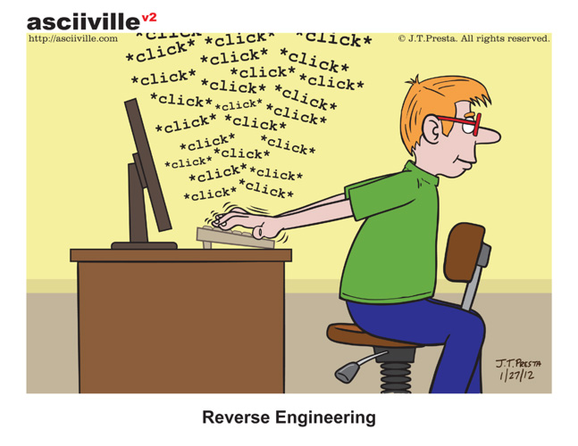
What is Reverse Engineering?
Anyone has an idea?

Slide 3
What is Reverse Engineering?
Similar to scientific studies of natural world. Things exist, try to understand it, model it, and potentially build something with it
To extract knowledge or design of anything *man-made*
Broad term, and the idea existed long before software engineering

Slide 4
A little more on this idea
Daily talking – tone, facial expression, etc
“Chinese” (or any other) bootleg / fake / illegally “similar” products - sometimes, other times reverse engineering isn’t even attempted ☹
Different layers – example with a lock
Purpose:
Mechanism:
Specifics (to open it): pin length, safety, etc
RE of machines – computer aided design

Slide 5
Software Reverse Engineering
Anyone want to try to name some common forms and use of software reverse engineering?

Slide 6
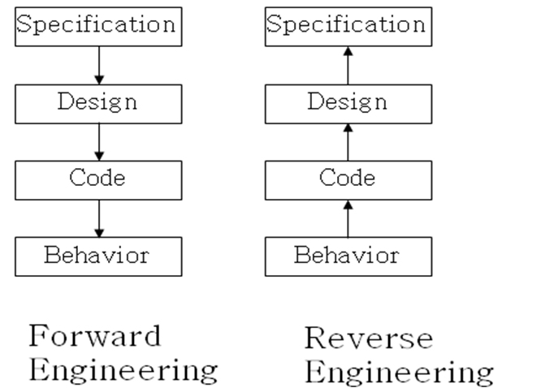
Software Reverse Engineering
And much more broader ideas of software RE

Slide 7
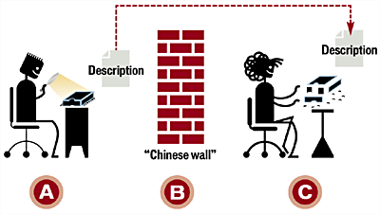
Applications of Software Reverse Engineering
Discovery/Prevention of malicious software
Reversing cryptic files or file formats
Adding features and reviving abandoned software
Evaluating quality and security of open source software
Hacking
Clean room approach (bad now) – more on legality later

Slide 8
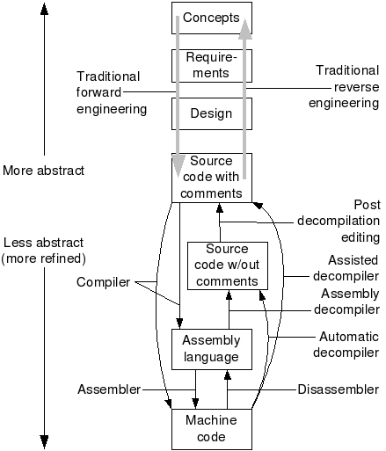
Different levels
Traditionally refers to higher level
Nowadays, a lot of RE refers to the lower, coding-based level

Slide 9
Types of Software Reverse Engineering
Source Present
Code Level
Use methods like ‘reversing’
Decompile and understand what the original engineers did and how it was implemented
Source Absent
System Level
Black box approach
Infer and discover the original component specifications
Work towards the overall high level design

Slide 10
Black Box Approach
Monitor Inputs and Outputs of a portion of the system
Use these results to create system specifications
Design the components yourself, with these specifications
Kind of like creating a UML diagram and Flow Chart for the system

Slide 11
Real World Example - Phoenix Technologies BIOS
Reverse engineered IBM’s BIOS to create a clone in the 1980s
Used Clean-Room technique to avoid copyright issues
Was one of many companies to attempt the cloning, one of few to succeed without infringement

Slide 12
Reversing
A way to link together low level and high level reverse engineering
Decompile – Translate the lowest level code into a more understandable level
Debug – Follow the code to understand the control flow
Decipher – Gain understanding of how the code works and over arching system

Slide 13
Real World Example – Adobe e-Book File Format
Russian programmer Dimitri Skylarov for a company called ElcomSoft
Reverse engineered Adobe’s proprietary file format
Could convert eBook files into .pdf files
Adobe sued but lost the case

Slide 14
Legal Implications
Laws have changed since then…
Most software now comes with licenses that prevent this
Ignoring the technicalities you still can given:
You lawfully obtain the program
You are granted permission from the copyright owner
You only use the results for non malicious purposes
You do not distribute your mutated program

Slide 15
Anti-reversing
Eliminate Symbolic Information
Only really an issue in higher level languages (.NET, Java etc)
Embedded Keys
Anti-debugging
Exception Swallowing
Checksums

Slide 16
Sources
“Reversing: Secrets of Reverse Engineering” Eilam, Eldad
http://en.wikipedia.org/wiki/Reverse_engineering
http://www.computerworld.com/article/2585652/app-development/reverse-engineering.html
https://jetbrains.com/decompiler/

